Slide 1
NIGHT
BY ELIE WIESEL
INTRO NOTES
BACKGROUND

Slide 2
NIGHT
BY ELIE WIESEL
This presentation will:
Introduce you to the events and importance of World War II
Familiarize you with the important characters in history
Supply background for the story of Elie Wiesel, his family, and his friends

Slide 3
NIGHT
BY ELIE WIESEL
Who was in World War II?

Slide 4
WWII > Who?
WWII > who?
The Allies
The Axis
United States of America
Nazi Germany
United Soviet Socialist Republic
japan
United Kingdom
Italy
China
Hungary
France
Romania
Poland
Bulgaria
Canada
Finland
Australia
Thailand
New Zealand
Iraq
South Africa
Netherlands

Slide 5
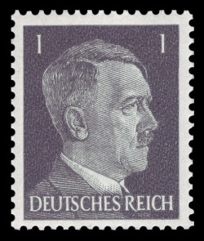
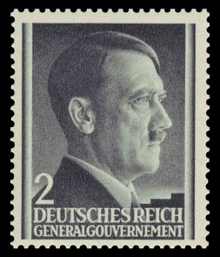
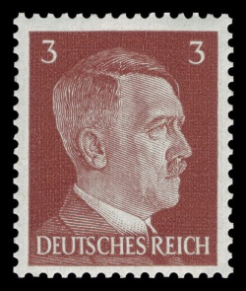
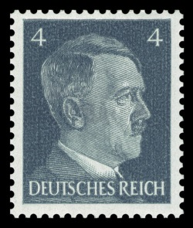
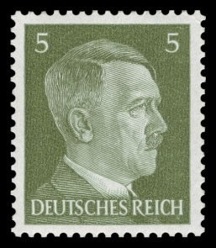
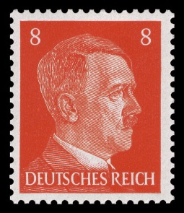
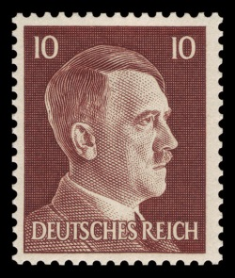
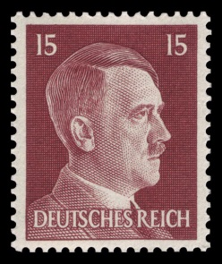
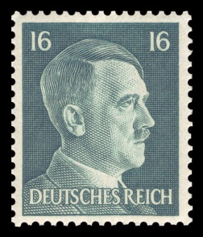
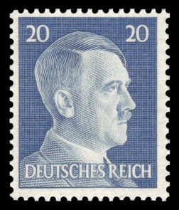
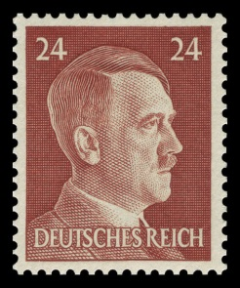
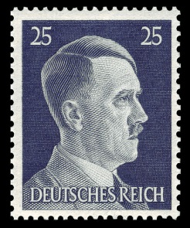
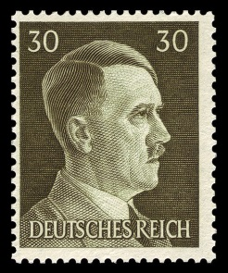
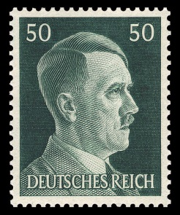
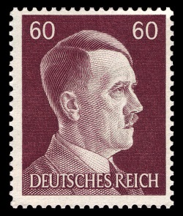
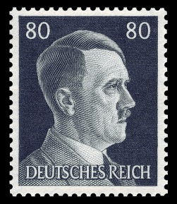
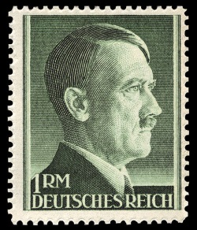
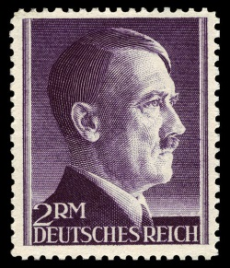
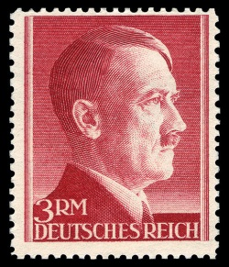
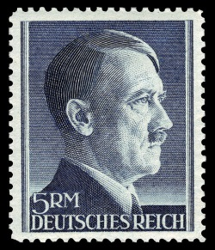
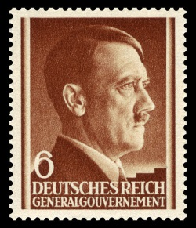
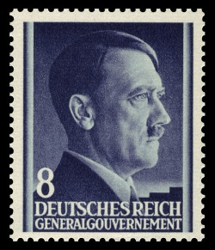
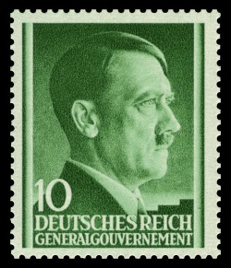
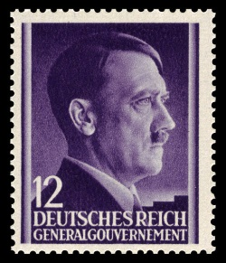
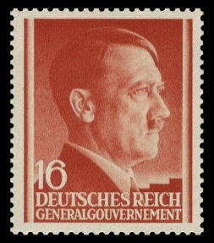
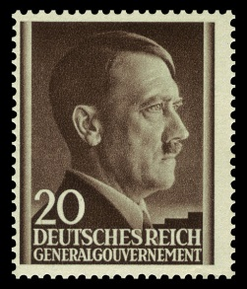
WWII > who?
Adolf Hitler

Slide 6
WWII > who was Hitler?
A German soldier in world war I
A powerful public speaker
The man Germany hoped would help fix their economic problems in the aftermath of world war I
The elected leader of Germany
The leader of the Nazi political party
An enemy of the Jewish people
The infamous initiator of the holocaust, one of the worst events in human history.
Adolf
Hitler

Slide 7
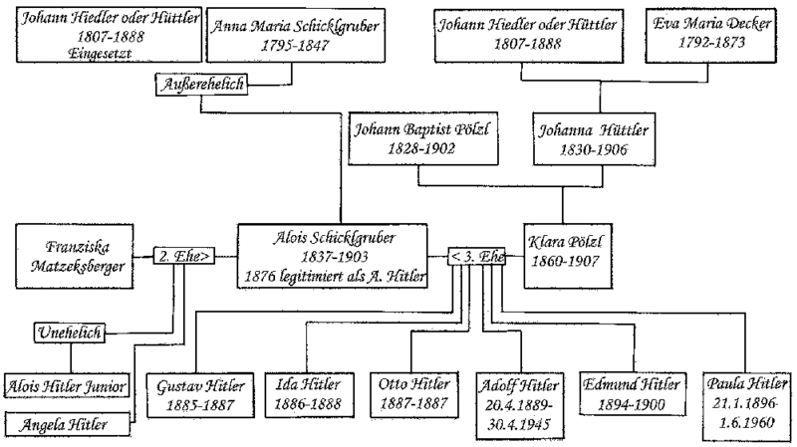
WWII > who was Hitler?
Adolf
Hitler
family
tree

Slide 8
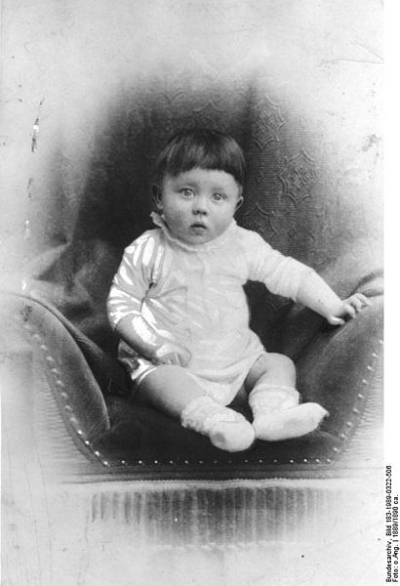
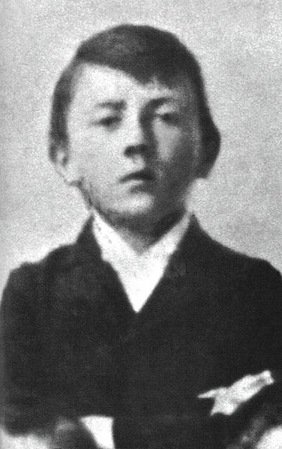
WWII > who was Hitler?
the
boy
Adolf Hitler as a baby
Adolf Hitler as a young boy

Slide 9
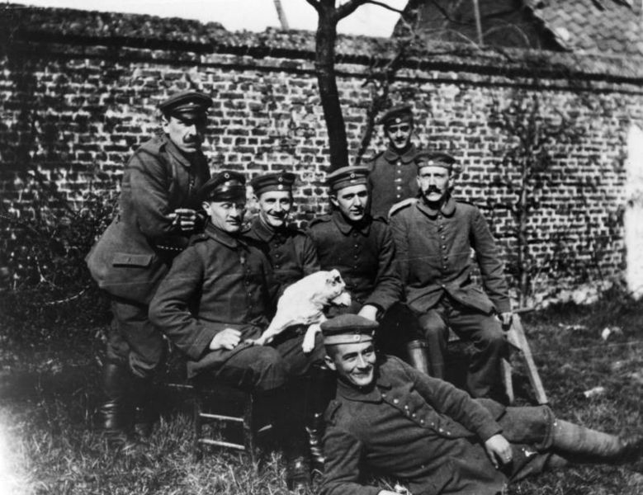
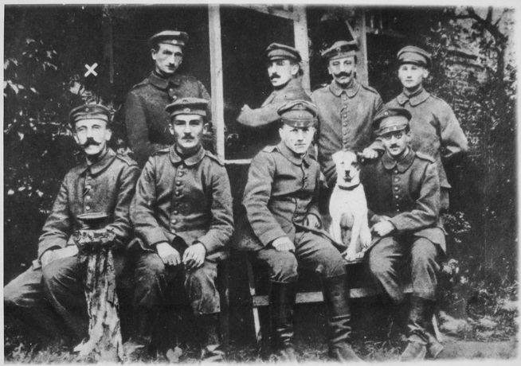
WWII > who was Hitler?
the
soldier
Adolf Hitler as a soldier in world war I
Adolf Hitler as a soldier in world war I

Slide 10
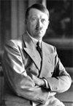
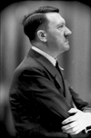
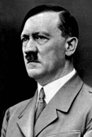
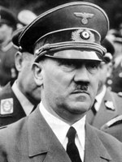
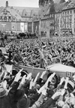
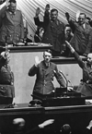
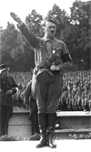
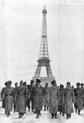
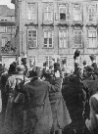
WWII > who was Hitler?
the
Fuhrer,
Chancellor of Germany

Slide 11
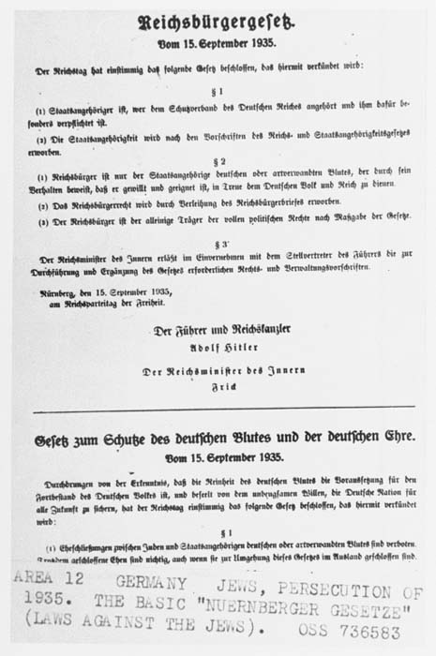
WWII > ANTISEMiTICISM
Antisemitism and the persecution of Jews represented a central tenet of Nazi ideology. In their 25-point Party Program, published in 1920, Nazi party members publicly declared their intention to segregate Jews from "Aryan" society and to abrogate Jews' political, legal, and civil rights.

Slide 12
NIGHT
BY ELIE WIESEL
Why did
World War II happen?

Slide 13
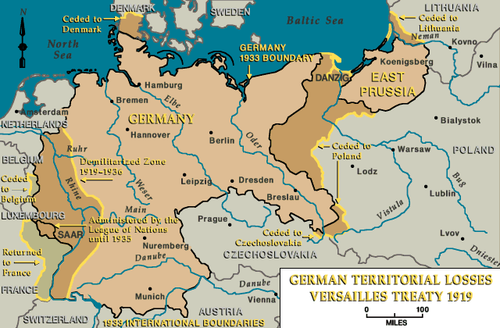
WWII > why did it happen?
Germany lost World War I. In the 1919 Treaty of Versailles, the victorious powers (the United States, Great Britain, France, and other allied states) imposed punitive territorial, military, and economic provisions on defeated Germany.
Germany lost a considerable amount of territory within Europe and around the world. Outside Europe, Germany lost all its colonies. In sum, Germany forfeited 13 percent of its European territory (more than 27,000 square miles) and one-tenth of its population (between 6.5 and 7 million people).
Most historians agree that Germany was humiliated at the end of World War I.

Slide 14
WWII > why did it happen?
world
war
Nationalistic tension
Unresolved issues from world war I
Effects of the great depression
Economic turmoil in Germany
Political vacuum in Germany
1937 Japanese invasion of china
1939 German invasion of Poland
1941 Japanese bombing of pearl harbor
II

Slide 15
NIGHT
BY ELIE WIESEL
What happened in World War II?

Slide 16
WWII > when?
Olympics begin in Berlin, Germany
Britain, France,
Australia, &
New Zealand declare war on Germany
Germans elect Nazis into power
Adolf Hitler becomes leader of Nazi Party
Assassination attempt on Hitler fails
1st concentration camp opened near Berlin
German military mobilizes
Elie Wiesel born
Nazis begin euthanasia on sick and disabled
U.S. Stock Market crashes
Adolf Hitler voted Chancellor of Germany
German Jews stripped
of rights.
Hitler reveals
war
plans.
World War I ends
Kristall-nacht
More timeline

Slide 17
WWII > when?
Nazis invade Netherlands
Nazis invade northern
Africa
Japan bombs Pearl Harbor
Allied Forces D-Day invasion
Japanese-Americans sent to US concentration camps
12-year-old Elie Wiesel begins studying Kabbalah
15-yr-old Elie & family deported
Nazis order Jews to wear yellow stars
Nazis bomb Britain
Jews fight back in Warsaw ghetto
Nazi mass murders start
Gas chambers
at Auschwitz
Hitler declares war on USA
More timeline

Slide 18
WWII > when?
Soviet Troops liberate Auschwitz
Elie is liberated from Buchenwald
USA drops nuclear bomb
on Nagasaki
USA drops nuclear bomb on Hiroshima
Elie travels to Jerusalem for the 1st time
Hitler commits suicide
Elie’s father dies in Buchenwald
State of Israel is created
Elie & father transfer to Buchenwald
Germany surrenders
Japan surrenders

Slide 19
NIGHT
BY ELIE WIESEL
What was the holocaust?
WARNING: Some of the upcoming images are intense and graphic in nature. They are not for the light of heart, but they are something that must be remembered, lest humankind falter and repeat our past mistakes.

Slide 20
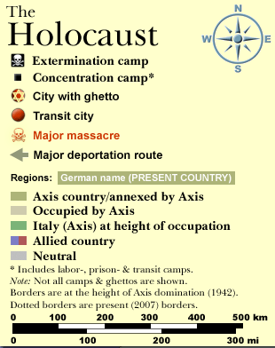
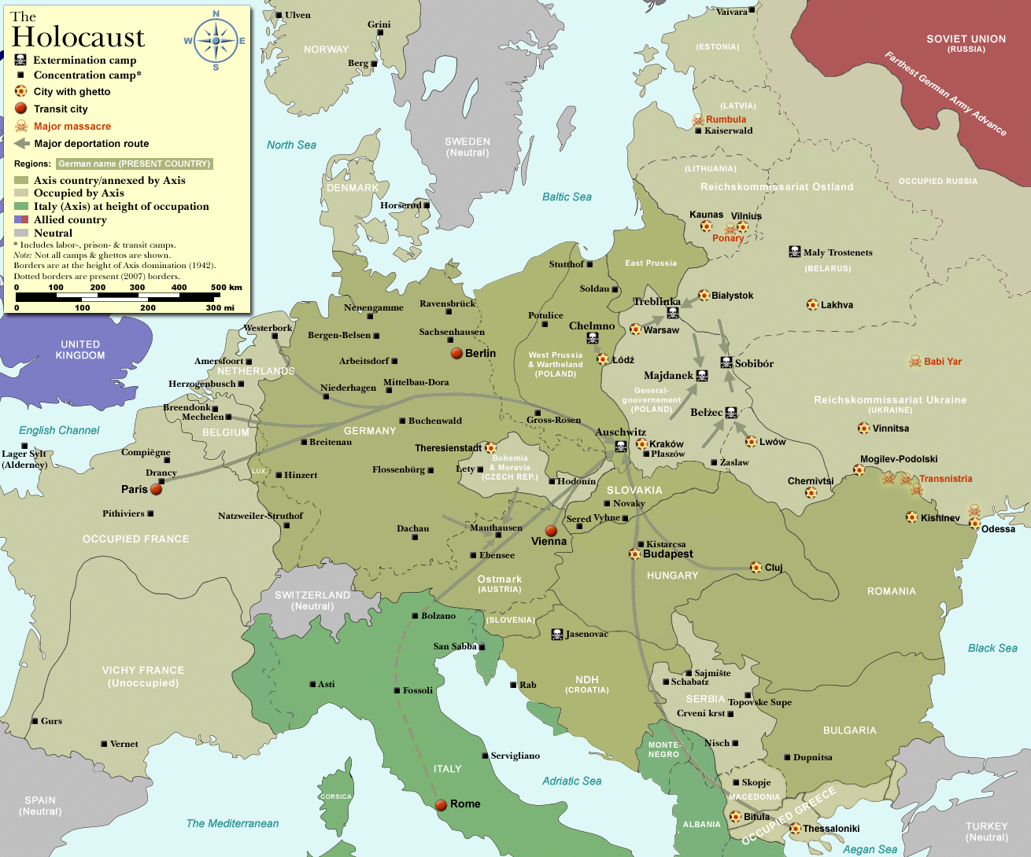
WWII > the holocaust
AUSCHWITZ – where ELIE AND FATHER WERE SENT
Buchenwald – where SCHLOMO DIED
BUCHENWALD– where
ELIE WAS LIBERATED
FROM

Slide 21
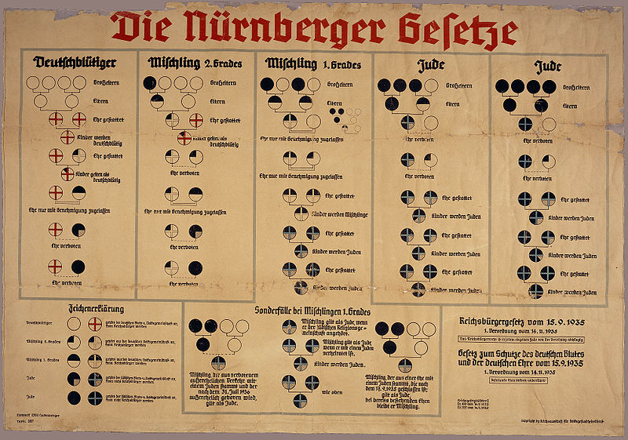
WWII > the holocaust
Flow charts were used to determine who was German and who was not.

Slide 22
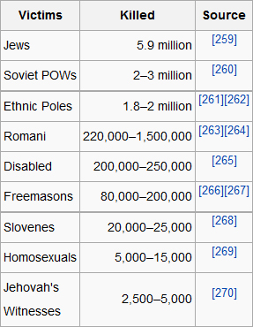
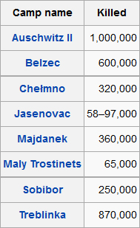
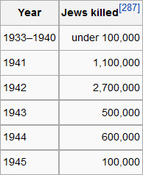
WWII > the holocaust

Slide 23
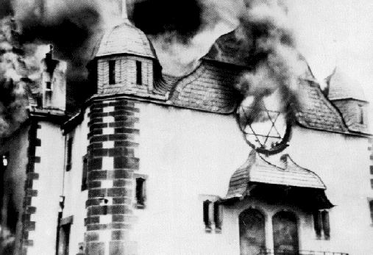
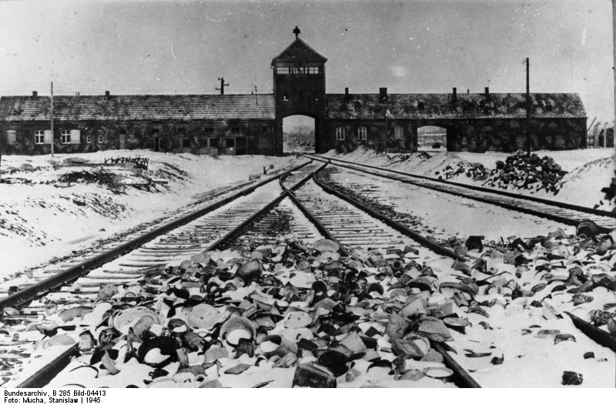
WWII > the holocaust
Synagogue in Warsaw ghetto
Auschwitz death camp
Jewish ghettos in Europe were parts of a number of cities in Europe in which Jews were permitted to live. In addition to being confined to ghettos, Jews were placed under strict regulations and disabilities in many European cities.

Slide 24
WWII > the holocaust

Slide 25
WWII > the holocaust
Josef Mengele was an SS physician, infamous for his inhumane medical experimentation upon concentration camp prisoners at Auschwitz.

Slide 26
NIGHT
BY ELIE WIESEL
Liberation

Slide 27
WWII > LIBERATION
Soviet soldiers were the first to liberate concentration camp prisoners in the final stages of the war. On July 23, 1944, they entered the Majdanek camp in Poland, and later overran several other killing centers. On January 27, 1945, they entered Auschwitz and there found hundreds of sick and exhausted prisoners. The Germans had been forced to leave these prisoners behind in their hasty retreat from the camp. Also left behind were victims' belongings: 348,820 men's suits, 836,255 women's coats, and tens of thousands of pairs of shoes.

Slide 28
NIGHT
BY ELIE WIESEL
Who was
Elie Wiesel?

Slide 29
WWII > who is Elie Wiesel?
One of the most discussed Jewish holocaust survivors
Born in Romania
Family was deported and bounced from camp to camp
Won Nobel peace prize in 1986
Born 9/30/28
Published night in 1960, but it took 3 years to sell 3,000 copies
Today, his memoir has been translated into 30 languages. It has been selected to Oprah Winfrey’s book club.
He refused to make a film.
Elie
Wiesel

Slide 30
WWII > who is Elie Wiesel?
Elie Wiesel's Home
In Sighet, Romania
2010 time 100
Photo credit: David Shankbone

Slide 31
WWII > who is Elie Wiesel?
2008 World Economic forum
Buchenwald, 1945. Wiesel is in the second row from the bottom, seventh from the left.
Return to the Concentration Camp

Slide 32
WWII > who is Elie Wiesel?
Elie Wiesel’s memoir
night

Slide 33
NIGHT
BY ELIE WIESEL
INTRO NOTES
BACKGROUND

